Slide 1
Guanya Seawater Desalination Solutions
Water Solutions for Islands, Marine & Remote Projects
GUANYA WATER SOLUTION | ISO-Certified Custom SWRO Factory
Notes:
[Sources]
- Guanya Sea water desalination machine catalogue (1).pptx — inherited design, photographs and certificate scans.
- Guanya_Product_Catalogue_Optimization_Recommendations(1).docx — customer-facing positioning.

Slide 2
Catalogue
Factory & Global
Products
Contact
01
02
03
04
05
06
About
Certifications
Delivery
Notes:
[Sources]
- Guanya Sea water desalination machine catalogue (1).pptx — inherited design, photographs and certificate scans.

Slide 3
About Guanya
ISO-certified water-treatment manufacturer with more than ten years of experience in process design, equipment manufacturing, factory FAT and international project delivery.
Notes:
[Sources]
- Guanya Sea water desalination machine catalogue (1).pptx — inherited design, photographs and certificate scans.
- Guanya Product catalogue 2026(1).pdf — company and manufacturing profile.

Slide 4
Engineering & Manufacturing Capability
One factory partner for design, manufacturing, FAT, export packing and worldwide technical support.
In-House Engineering
Worldwide Support
01
02
03
10+ Years of Experience
Pretreatment, SWRO, electrical control and energy options are configured around each project.
International shipment coordination, installation guidance and remote technical service.
Focused on water-treatment equipment, customized engineering and reliable factory production.
Notes:
[Sources]
- Guanya Sea water desalination machine catalogue (1).pptx — inherited design, photographs and certificate scans.
- Guanya Product catalogue 2026(1).pdf — engineering and manufacturing capability.

Slide 5
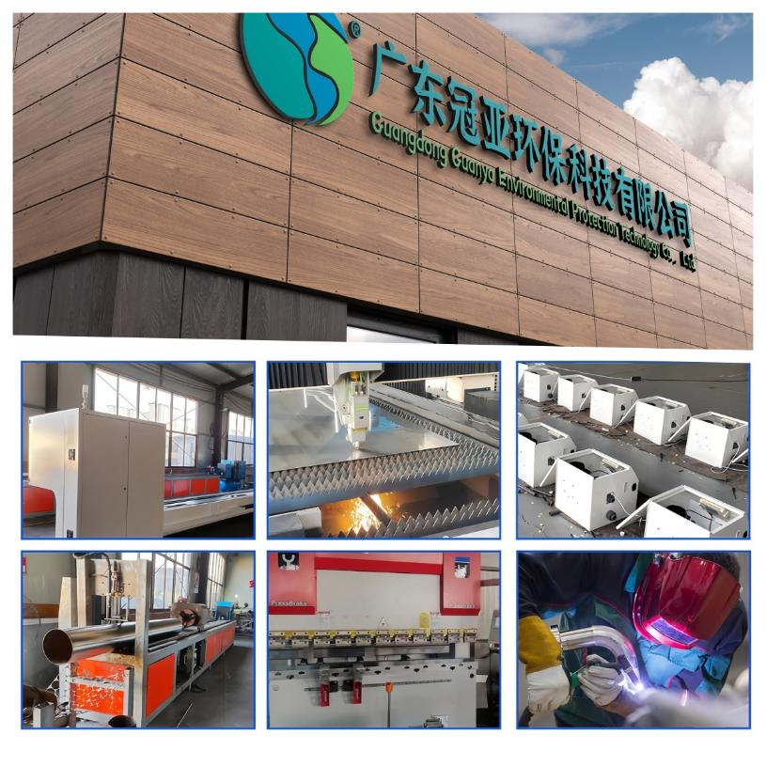

Notes:
[Sources]
- Guanya Sea water desalination machine catalogue (1).pptx — inherited design, photographs and certificate scans.
- Factory photographs — company building, fabrication, electrical assembly and production staff.

Slide 6
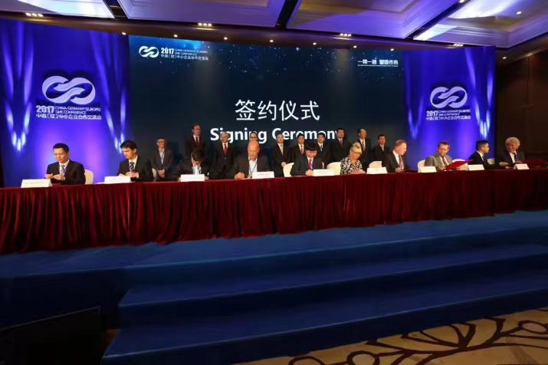
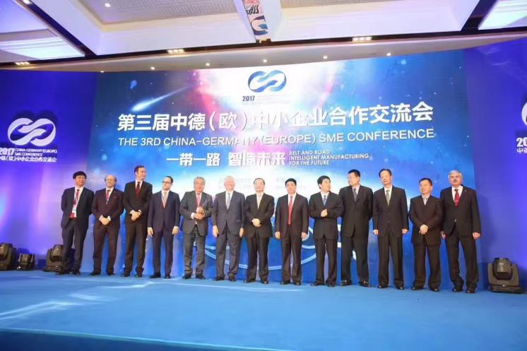
Notes:
[Sources]
- Guanya Sea water desalination machine catalogue (1).pptx — inherited design, photographs and certificate scans.
- International cooperation and signing-ceremony photographs.

Slide 7
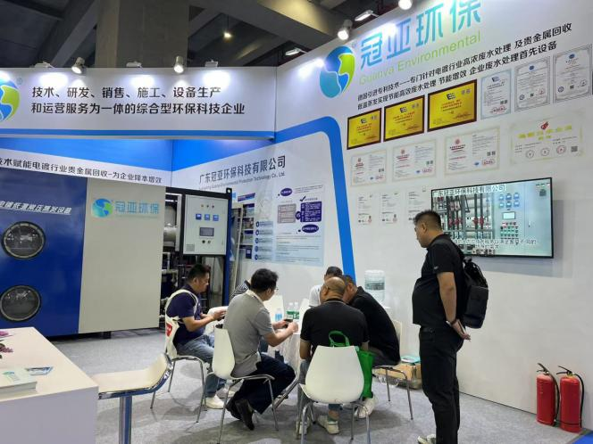
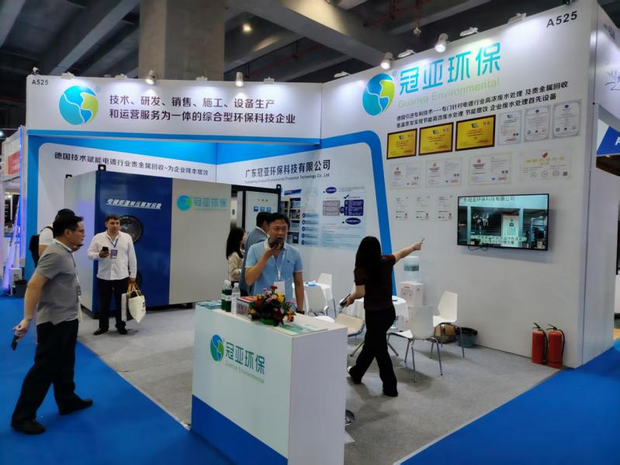
Notes:
[Sources]
- Guanya Sea water desalination machine catalogue (1).pptx — inherited design, photographs and certificate scans.
- International water-industry exhibition photographs.

Slide 8
Quality Systems & Certifications
Certified management systems and controlled factory production.
01
02
03
ISO Management Systems
Manufacturing Control
FAT Before Shipment
ISO 9001 quality, ISO 14001 environmental and ISO 45001 occupational health & safety management.
Incoming inspection, controlled assembly, pressure testing, electrical integration and documented inspection.
Pump, instrument, PLC, alarm and operating-function checks are completed before packing and delivery.
Notes:
[Sources]
- Guanya Sea water desalination machine catalogue (1).pptx — inherited design, photographs and certificate scans.
- Guanya Product catalogue 2026(1).pdf — ISO certifications.
- Guanya_Mining_Water_Treatment_Catalogue_South_America_20260609175103.pdf — FAT workflow only.

Slide 9
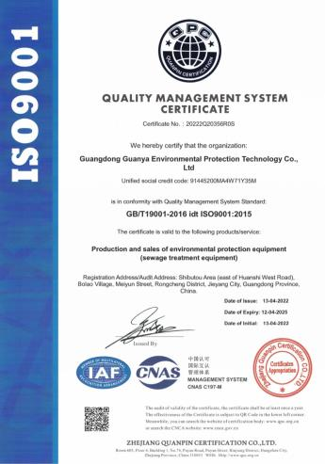
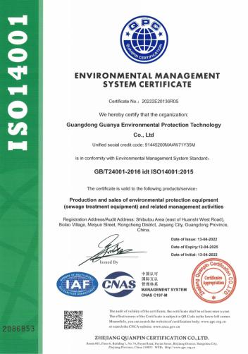

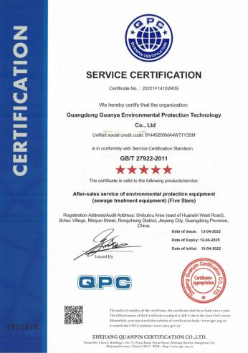
Notes:
[Sources]
- Guanya Sea water desalination machine catalogue (1).pptx — inherited design, photographs and certificate scans.
- Qualification and service-certificate scans.

Slide 10
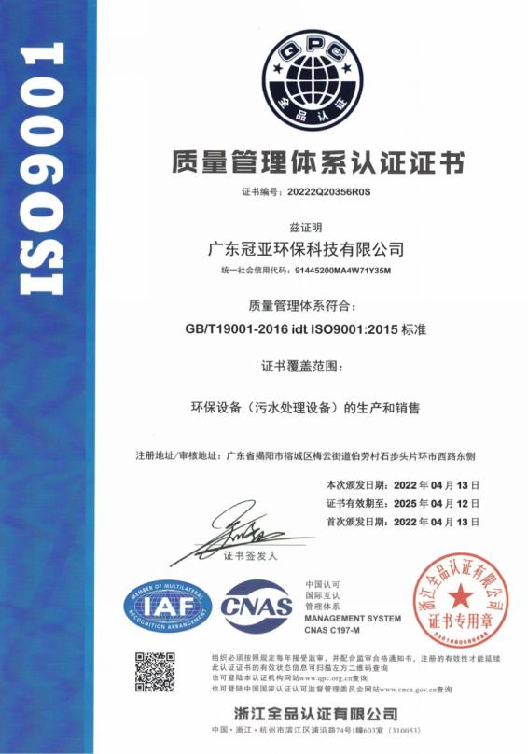
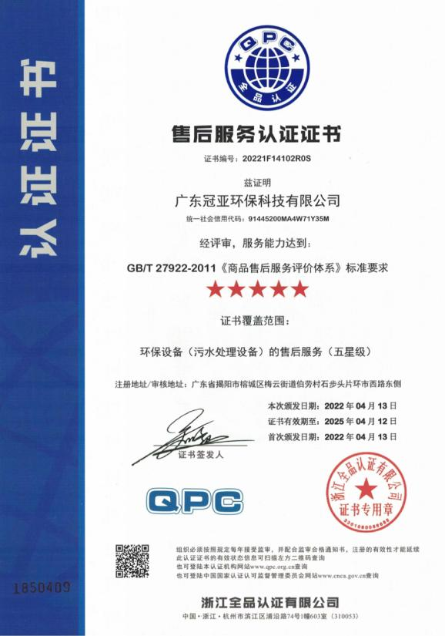
Notes:
[Sources]
- Guanya Sea water desalination machine catalogue (1).pptx — inherited design, photographs and certificate scans.
- ISO 9001 certificate scans.

Slide 11
Seawater Desalination Product Portfolio
Portable SWRO • Solar / Hybrid SWRO • Skid-Mounted SWRO • Containerized SWRO • Marine Watermakers
Reference capacity: 0.56–600 m³/day. Every final system is configured for the actual feed water, product-water target, site and power supply.
Notes:
[Sources]
- Guanya Sea water desalination machine catalogue (1).pptx — inherited design, photographs and certificate scans.
- Guanya_RO_International_Specifications_Enhanced(1).xlsx — reference capacity range.

Slide 12
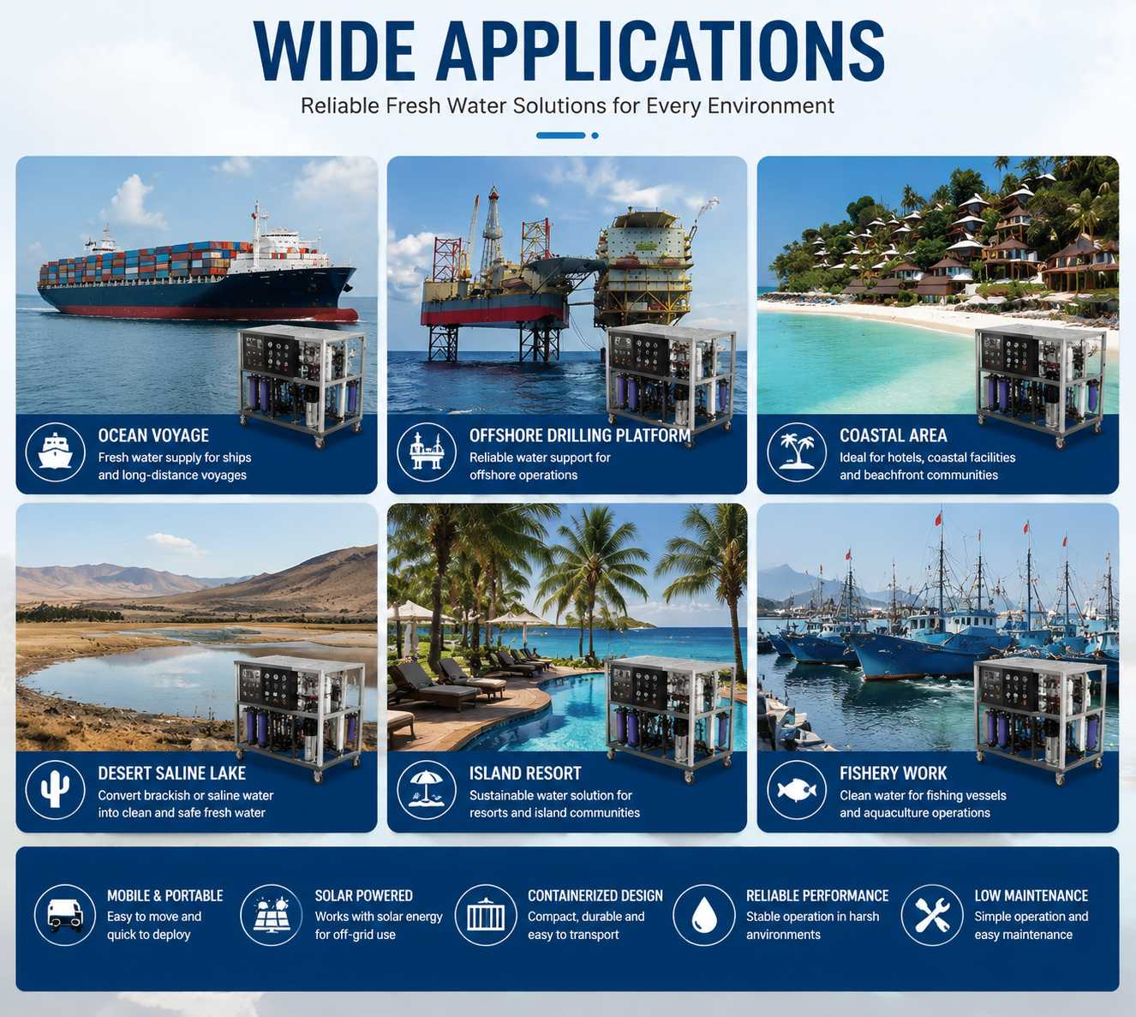
GLOBAL APPLICATION COVERAGE
SHIPS & LONG VOYAGES
Reliable freshwater production on board.
OFFSHORE & COASTAL PROJECTS
Compact supply for platforms and remote marine operations.
ISLAND RESORTS & COMMUNITIES
Stable water for hotels, villages and tourism facilities.
MOBILE, SOLAR & CONTAINERIZED
Each format is engineered for site, capacity and power conditions.
Notes:
[Sources]
- Guanya Sea water desalination machine catalogue (1).pptx — inherited design, photographs and certificate scans.
- 677.jpg — newly supplied wide-application visual.
- Guanya_Product_Catalogue_Optimization_Recommendations(1).docx — priority customer applications.

Slide 13
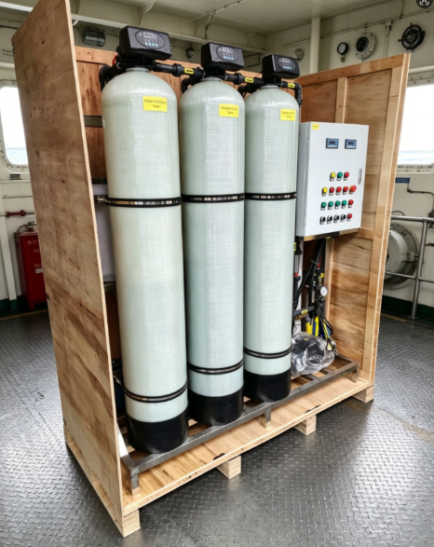
Portable SWRO Systems
Compact Freshwater Production for Remote Locations
• Reference capacity: 0.56–4.10 m³/day (28–205 L/h), based on 20 operating hours/day.
• Compact frame with 360° wheels for easy movement, loading and transport.
• Suitable for islands, hotels, yachts, workboats, remote communities and emergency supply.
• Grid, generator, ship power or solar / hybrid integration can be engineered.
• SWRO for seawater; BWRO configuration is available for brackish-water sources.
Notes:
[Sources]
- Guanya Sea water desalination machine catalogue (1).pptx — inherited design, photographs and certificate scans.
- Guanya_RO_International_Specifications_Enhanced(1).xlsx — portable capacity and power options.

Slide 14
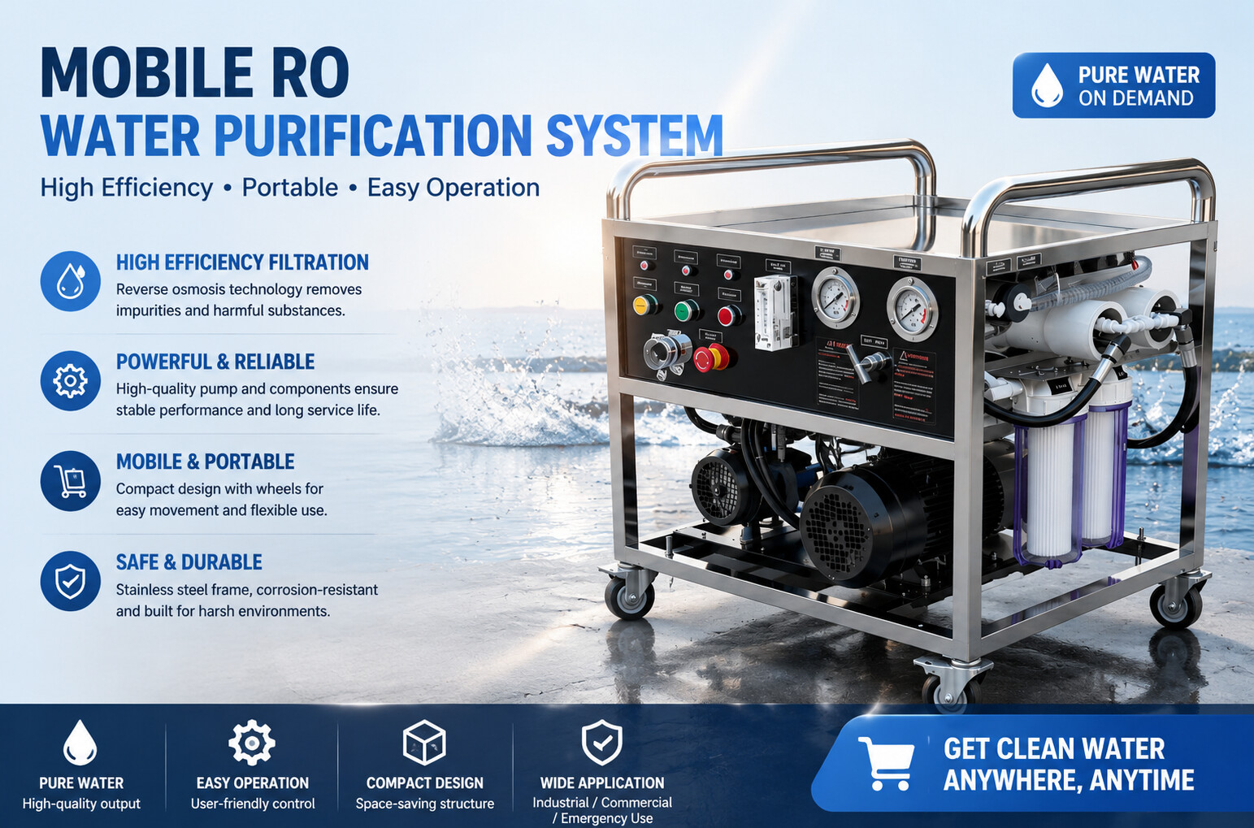
Notes:
[Sources]
- Guanya Sea water desalination machine catalogue (1).pptx — inherited design, photographs and certificate scans.
- 1111(1).png — newly supplied mobile RO product visual; optimized for PPT embedding without changing content.
- Guanya_RO_International_Specifications_Enhanced(1).xlsx — control and customization options.

Slide 15
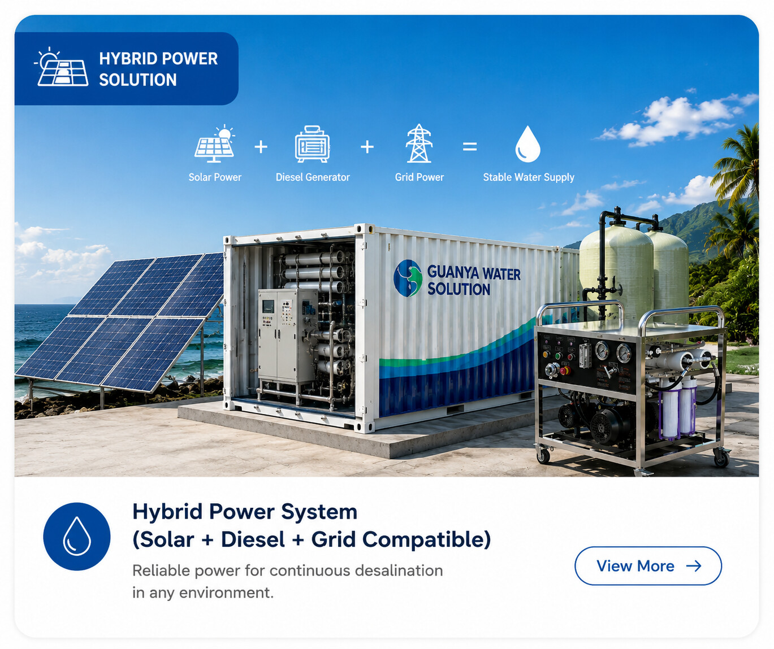
HYBRID POWER FLEXIBILITY
SOLAR-FIRST OPERATION
Use available renewable energy for remote and island projects.
GENERATOR BACKUP
Maintain water production when solar conditions are limited.
GRID COMPATIBILITY
Connect to local utility power where infrastructure is available.
PROJECT-SPECIFIC DESIGN
Power configuration is matched to capacity, operating hours and site conditions.
Notes:
[Sources]
- Guanya Sea water desalination machine catalogue (1).pptx — inherited design, photographs and certificate scans.
- 39.png — newly supplied hybrid-power solution visual; optimized for PPT embedding without changing content.
- Guanya_RO_International_Specifications_Enhanced(1).xlsx — solar integration and power options.

Slide 16
ISLAND FRESHWATER CHALLENGES
REMOTE LOCATION
Limited freshwater source and difficult logistics.
GROWING TOURISM DEMAND
Guest rooms, restaurants, pools and daily operation require stable supply.
LIMITED INFRASTRUCTURE
Civil construction, grid power and technical support may be restricted.
GUANYA RESPONSE
Factory-built SWRO with containerized, solar / hybrid and remote-monitoring options.
Notes:
[Sources]
- Guanya Sea water desalination machine catalogue (1).pptx — inherited design, photographs and certificate scans.
- 02_Island_Freshwater_Challenges.webp — newly supplied island freshwater challenge visual.
- Guanya_Product_Catalogue_Optimization_Recommendations(1).docx — island and resort positioning.

Slide 17
20 m³/DAY COMPACT SWRO
REFERENCE CONFIGURATION
Skid-mounted seawater RO for approximately 20,000 L/day freshwater production.
IDEAL FOR
Island hotels, restaurants, resorts, coastal sites and small communities.
CONFIGURATION OPTIONS
DuPont FilmTec (DOW) or VONTRON membranes; Danfoss or CNP / South Pump; PLC, CIP, remote monitoring and solar / hybrid integration.
Final performance is confirmed after feed-water analysis.
Notes:
[Sources]
- Guanya Sea water desalination machine catalogue (1).pptx — inherited design, photographs and certificate scans.
- 01-20tpd-seawater-desalination-system(1).webp — newly supplied 20 T/day product visual.
- Guanya_RO_International_Specifications_Enhanced(1).xlsx — capacity, brands and system options.

Slide 18
Space-Saving • Modular • Ready to Ship
COMPACT FACTORY-BUILT DESIGN
Integrated pretreatment, membrane units, pumping, dosing and electrical control reduce on-site installation work.
EASY TRANSPORT & INSTALLATION
The skid is assembled, inspected and tested before shipment.
FULL CUSTOMIZATION
Capacity, materials, voltage / frequency, membrane and pump brands, PLC, CIP and remote monitoring are selected for each project.
Multiple skids can be installed in parallel for future expansion.
Notes:
[Sources]
- Guanya Sea water desalination machine catalogue (1).pptx — inherited design, photographs and certificate scans.
- 06-compact-skid-mounted-design(1).webp — newly supplied compact skid-mounted system visual.
- Guanya_RO_International_Specifications_Enhanced(1).xlsx — project-specific engineering disclaimer.

Slide 19
Containerized SWRO Systems
20 ft / 40 ft Factory-Built Water Plants
01
02
03
Integrated
Climate Adapted
Easy Expansion
Pretreatment, SWRO, piping, dosing, electrical control and optional CIP are assembled and tested before shipment.
Insulation, ventilation or air conditioning, anti-corrosion treatment and low-noise options are available.
Standard container modules simplify international transport, rapid deployment and future capacity expansion.
Notes:
[Sources]
- Guanya Sea water desalination machine catalogue (1).pptx — inherited design, photographs and certificate scans.
- Guanya_RO_International_Specifications_Enhanced(1).xlsx — container and environmental options.

Slide 20
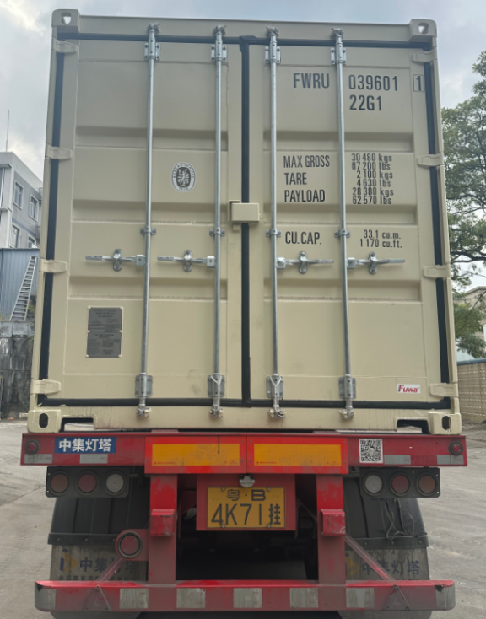
CONTAINERIZED SWRO
FACTORY ASSEMBLED
Pretreatment, reverse osmosis, piping, valves, dosing and electrical control are integrated before shipment.
TRANSPORT-READY FORMAT
Standard 20 ft / 40 ft container dimensions simplify road and sea transport.
PLUG & PLAY CONNECTION
The site normally prepares the foundation, feed-water connection, power and product-water outlet.
CUSTOM ENVIRONMENTAL DESIGN
Insulation, air conditioning, ventilation, anti-corrosion and low-noise options can be selected.
Notes:
[Sources]
- Guanya Sea water desalination machine catalogue (1).pptx — inherited design, photographs and certificate scans.

Slide 21
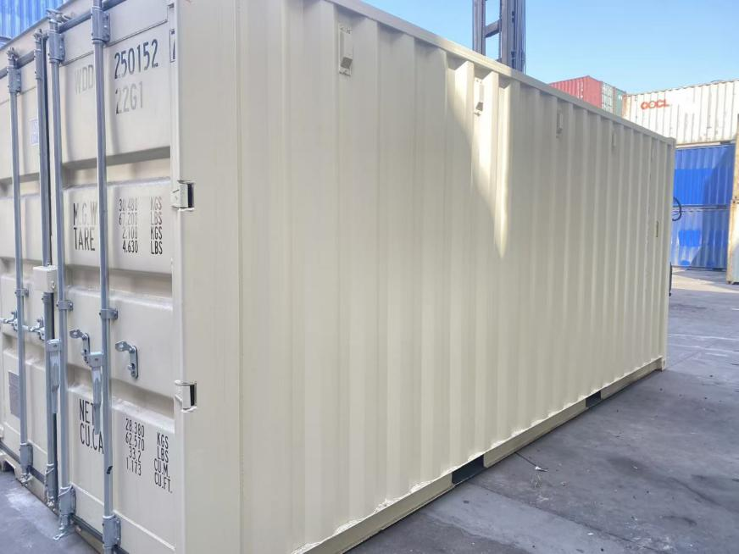
RAPID SITE DEPLOYMENT
• Factory-preassembled and tested before shipment
• Minimal site foundation and utility connections
• Standard container lifting and transport points
• Suitable for islands, coastal sites and remote projects
COASTAL ENVIRONMENT OPTIONS
Anti-corrosion coating, salt-spray protection, thermal insulation, ventilation and air conditioning can be configured.
Notes:
[Sources]
- Guanya Sea water desalination machine catalogue (1).pptx — inherited design, photographs and certificate scans.

Slide 22
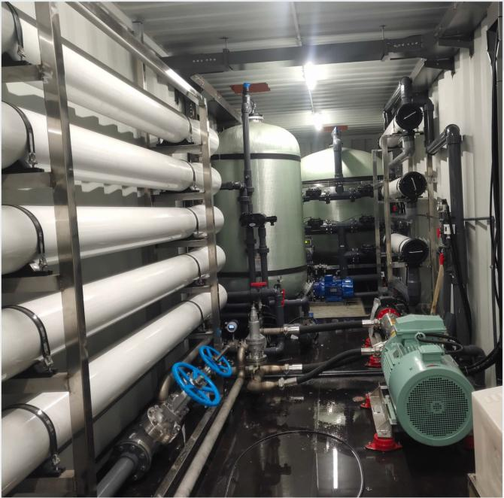
INTEGRATED CONTAINER INTERIOR
• Organized piping and valve layout
• High-pressure pump and membrane trains
• PLC control and alarm functions
• Conductivity, pressure and flow monitoring
• Optional CIP cleaning system
• Remote monitoring available
All internal equipment is configured to the selected capacity, feed water and product-water requirements.
Notes:
[Sources]
- Guanya Sea water desalination machine catalogue (1).pptx — inherited design, photographs and certificate scans.

Slide 23
Marine Watermakers
01
02
03
04
Marine-Ready Design
Compact Size
Power Compatibility
Automatic Protection
Corrosion-resistant materials and secure component layout support vessels and offshore facilities.
Skid, cabinet or compact frames fit engine rooms, decks and other space-limited areas.
PLC control, alarms and water-quality monitoring simplify operation and protect the RO system.
Voltage, frequency and shipboard power interfaces are engineered for each vessel.
Notes:
[Sources]
- Guanya Sea water desalination machine catalogue (1).pptx — inherited design, photographs and certificate scans.

Slide 24
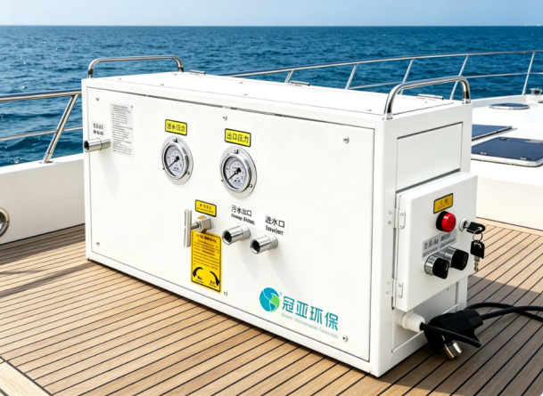
MARINE SWRO EQUIPMENT
CORROSION-RESISTANT DESIGN
Materials and coatings are selected for high-salinity, high-humidity marine environments.
COMPACT INSTALLATION
Skid, cabinet and modular configurations can fit decks, engine rooms and equipment compartments.
STABLE OPERATION
Pressure, conductivity, alarms and automatic protection support reliable water production on board.
CUSTOM POWER INTERFACE
Voltage, frequency and control integration are matched to the vessel or offshore facility.
Notes:
[Sources]
- Guanya Sea water desalination machine catalogue (1).pptx — inherited design, photographs and certificate scans.

Slide 25
ISLAND RESORT WATER SUPPLY
STABLE FRESHWATER PRODUCTION
For guest rooms, restaurants, kitchens, swimming pools, staff facilities and daily resort operation.
CONTAINERIZED DELIVERY
Factory assembly and FAT reduce site work and simplify international transport.
MODULAR CAPACITY
Projects from 60–1,000 m³/day can be configured through one or multiple SWRO trains.
REMOTE-SITE OPTIONS
Solar / hybrid power, low-noise design, insulation, air conditioning and remote monitoring are available.
Notes:
[Sources]
- Guanya Sea water desalination machine catalogue (1).pptx — inherited design, photographs and certificate scans.
- 01_Island_Resort_Hero.webp — newly supplied island resort water-supply visual.
- Guanya_Product_Catalogue_Optimization_Recommendations(1).docx — island resort application positioning.

Slide 26
Core Treatment Technologies
Pretreatment + SWRO
01
Pretreatment protects the high-pressure SWRO stage. Reference salt rejection is typically 99.2%; final performance depends on feed water and membrane selection.
Stable Water Quality
Designed Around the Feed Water
Energy Management
02
High-efficiency pumps and an optional energy recovery device can be selected for larger systems.
03
Water Quality & Hygiene
Product conditioning, UV or ozone disinfection and hygienic piping can be configured for the intended use.
Notes:
[Sources]
- Guanya Sea water desalination machine catalogue (1).pptx — inherited design, photographs and certificate scans.
- Guanya_RO_International_Specifications_Enhanced(1).xlsx — reference rejection and energy-recovery options.

Slide 27
Reference Capacity Guide
Daily Capacity Is the Primary International Reference
03
01
02
Small / Medium SWRO
Portable SWRO
Large SWRO
0.56–4.10 m³/day
(28–205 L/h)
Mobile frame or portable case; solar / hybrid option; small remote and marine demand.
6–200 m³/day
(0.3–10 m³/h)
Skid-mounted or containerized; PLC and CIP; resorts, communities and vessels.
300–600 m³/day
(15–30 m³/h)
20 ft / 40 ft container or engineered skid; remote monitoring and energy recovery available.
Notes:
[Sources]
- Guanya Sea water desalination machine catalogue (1).pptx — inherited design, photographs and certificate scans.
- Guanya_RO_International_Specifications_Enhanced(1).xlsx — 20-hour/day reference capacity bands.

Slide 28
Customer Reference Specifications
SWRO / BWRO — Final Values Confirmed After Feed-Water Analysis
01
02
03
Design Basis
Performance
Equipment Options
Type: SWRO / BWRO
Capacity: 0.56–600 m³/day
Flow: 28 L/h–30 m³/h
Basis: 20 operating h/day
Feed TDS: <40,000 / <10,000 ppm
Temperature: 5–45 °C
Salt rejection: 99.2% reference
Product TDS: SWRO ≤500 mg/L
BWRO ≤300 mg/L
Pressure: SWRO 3.5–5.5 MPa
BWRO 10–25 bar
Recovery: SWRO 30–35%; BWRO 60–70%
Format: Portable / skid / 20 ft / 40 ft
Membrane: DuPont FilmTec / VONTRON
Pump: Danfoss / CNP South Pump
Options: PLC, remote monitoring, CIP, energy recovery, low-noise, insulation / A/C and solar / hybrid
ALL SYSTEMS CUSTOMIZABLE
Notes:
[Sources]
- Guanya Sea water desalination machine catalogue (1).pptx — inherited design, photographs and certificate scans.
- Guanya_RO_International_Specifications_Enhanced(1).xlsx — model ranges, performance references, brand options and customization.

Slide 29
Every System Can Be Customized
Water & Capacity
Mechanical & Electrical
Brands & Automation
All published values are reference only. Feed source, salinity, product-water target, capacity, recovery and operating hours determine the final SWRO / BWRO design.
Skid or container, total shape, materials, voltage / frequency, insulation, air conditioning, noise control and site protection.
Membrane and pump brands, PLC / HMI, remote monitoring, CIP, energy recovery, solar / hybrid power, OEM appearance and documentation.
01
02
03
Notes:
[Sources]
- Guanya Sea water desalination machine catalogue (1).pptx — inherited design, photographs and certificate scans.
- Guanya_RO_International_Specifications_Enhanced(1).xlsx — customization options.

Slide 30
From Water Analysis to Worldwide Delivery
Analysis & Design
Manufacturing & FAT
Shipment & Support
Feed-water review → process selection → capacity and energy calculation → equipment layout.
Fabrication → piping and electrical integration → PLC programming → FAT documentation.
Export packing → global shipment → installation guidance → remote technical support.
01
02
03
Notes:
[Sources]
- Guanya Sea water desalination machine catalogue (1).pptx — inherited design, photographs and certificate scans.
- Guanya_Product_Catalogue_Optimization_Recommendations(1).docx — delivery workflow.
- Guanya_Mining_Water_Treatment_Catalogue_South_America_20260609175103.pdf — FAT and support structure only.

Slide 31
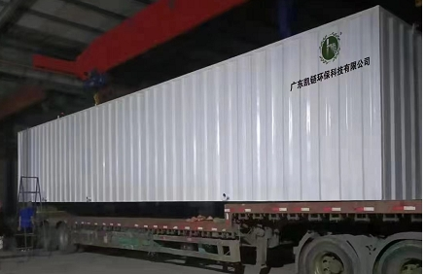
Notes:
[Sources]
- Guanya Sea water desalination machine catalogue (1).pptx — inherited design, photographs and certificate scans.
- Guanya containerized equipment shipment photograph.

Slide 32
Why Choose Guanya
Factory-Direct Engineering for International Projects
01
02
03
Factory Direct
Flexible Customization
Commercial Advantage
ISO-certified manufacturer with 10+ years of water-treatment experience and in-house production.
System type, capacity, materials, power, membrane, pump, control and solar options are customizable.
Competitive factory pricing, global delivery and a typical 35–45 day lead time after design confirmation.
Notes:
[Sources]
- Guanya Sea water desalination machine catalogue (1).pptx — inherited design, photographs and certificate scans.
- Guanya_RO_International_Specifications_Enhanced(1).xlsx — customization and delivery reference.

Slide 33
Let’s Design Your Water Solution
Cindy Zheng | International Sales
export@guanyahb.com | WhatsApp: +86 199 2672 5289
www.guanyaenvironmental.com
Guangdong Guanya Environmental Protection Technology Co., Ltd.
Send feed-water analysis, capacity, water target and site / power data for a customized proposal.
Notes:
[Sources]
- Guanya Sea water desalination machine catalogue (1).pptx — inherited design, photographs and certificate scans.
- Guanya_RO_International_Specifications_Enhanced(1).xlsx — current contact details.

